Slide 1







Reusable First Stage Booster Rocket Success Rate Analysis
Forest Kingfisher
01APR2023

Slide 2



Table of Contents
Executive Summary
Introduction
Methodology
data collection and data wrangling
EDA and interactive visual analytics
predictive analysis
Results
EDA with visualization
EDA with SQL
interactive map with Folium
Plotly Dash dashboard
predictive analysis (classification)
Conclusion
Appendix

Slide 3

EXECUTIVE SUMMARY
Data Analysis
Data collected from public sources
Machine learning models were built and compared
Data visualizations on dashboards provided to assist with decisions
Summary of Results
Optimal model determines
Significant factors that contribute to launch failure
Reusable booster landing success rate
Accuracy of predictions
GIT HUB Link for all notebooks and code: https://github.com/forestwhite/MachineLearning/tree/master

Slide 4
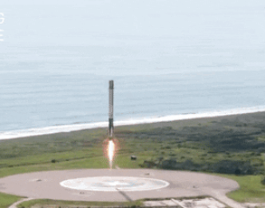
INTRODUCTION
To compete in the space rocketry market, Space Y sponsored data science research (this presentation) to determine the cost and reusability of stage 1 booster rockets from public data on Space X Falcon 9 rockets
Space X currently offers cheaper launches than competitors
SpaceX advertises Falcon 9 rocket launches on its website with a cost of 62 million dollars
other providers cost upwards of 165 million dollars each
much of the savings is attributed to reusing the first stage booster
Space Y wants to determine:
What are the significant factors that contribute to launch failures?
What is the success rate of reusable booster landing?
How accurate are the results?

Slide 5
METHODOLOGY: Data Collection
Data Collection is performed by two methods, both of which result in a usable Pandas dataframe, summarized in the table below:
REST API | Web Scraping
Request SpaceX launch data from SpaceX API using HTTP Receive response in JSON format Parse response into a pandas data frame Filter the data frame to only include Falcon 9 launches | Request HTML from Falcon 9 Launch Wiki page using its URL Parse HTML code using Beautiful Soup object Find the launch data HTML table Read column names from HTML table Create python dictionary keyed by the column names Read HTML table rows/cells into dictionary Construct a dataframe from the dictionary

Slide 6
METHODOLOGY: Data Wrangling
Whichever data collection method we use, the data isn't ready to use until we perform some filtering and standardization. This process is as follows:
Deal with Missing Values
Calculate success/failure landing metric (new column = class) using the various mission outcomes
Standardize data with 1-hot encoding and/or normalization to make factors comparable

Slide 7
METHODOLOGY: EDA with SQL
Here are the SQL queries we used to progressively evaluate the factors in our data:
List the names of the unique launch sites in the space mission
List 5 records where launch sites begin with the string 'CCA'
List the total payload mass carried by boosters launched by NASA (CRS)
List the average payload mass carried by booster F9 version 1.1
Find the date for the first successful landing outcome on a ground pad
List the names of boosters using in successful drone ship landings with payload masses between 4000 and 6000 kg
List the total number of successful and failure mission outcomes
List the names of the booster versions used with the maximum payload mass
List the failed landing outcomes in drone ship, the month, their booster versions, and launch site names that occurred in 2015
Rank the count of landing outcomes (such as Failure (drone ship) or Success (ground pad)) between the dates 2010-06-04 and2017-03-20, in descending order

Slide 8
METHODOLOGY: EDA with interactive visual analytics
Visual EDA involved two visualization methods:
Folium maps with markers to show the Space X launch sites and all the successful and failed launches at these sites:
Red represents rocket launch failures
Green represents the successes.
and their nearest important landmarks, including:
railways, highways, cities and coastlines
Polylines that connect the launch sites to these landmarks
2. Plotly charts:
Scatter plot - Flight Number vs Payload Mass , Flight Number vs Launch Sites , Payload and Launch Sites , Flight Number and Orbit Type , Payload and Orbit Type
Bar chart – Success rate of each orbit
Line plot – success rate and Date
3. Interactive dashboard with Dash:
A dropdown to filter results by launch site
A pie chart and scatter plot to visualize rocket launch success rates per launch site. Successful launches were represented by 1 while failures were represented by 0.
Labelling and coloring of factors that may influence the success rate of each site, such as the payload mass and booster versions.

Slide 9
METHODOLOGY: predictive analysis
We used the scikit-learn machine learning library to build models for predictive analysis using the following process for each model to predict if the first stage booster will successfully land given the data:
Create a column for the success/failure class (see data wrangling)
Standardize the data (see data wrangling)
Split data into training data and test data
Create a Grid SearchCV object and fit different Machine learning objects.
Calculate the accuracy on the test data
Once we had comparable ML models, we could complete the analysis by:
Comparing the ML methods by accuracy
Comparing the model predictions with the real labels (confusion matrix)

Slide 10
RESULTS: Summary
Exploratory data analysis (EDA) indicate that successful landing outcomes have some correlation with flight number. It also indicates that successful landing outcomes increase in frequency from 2015 onward.
All launch sites were located near a coastline, so we had no data to compare coastal launch sites to inland launch sites.
All launch sites were also located near highways and railways, so we had no data to compare launch sites near these features to launch sites that were distant from them.
Several machine learning models predicted landing success of any launch in a test data set with an 83.33% accuracy.

Slide 11
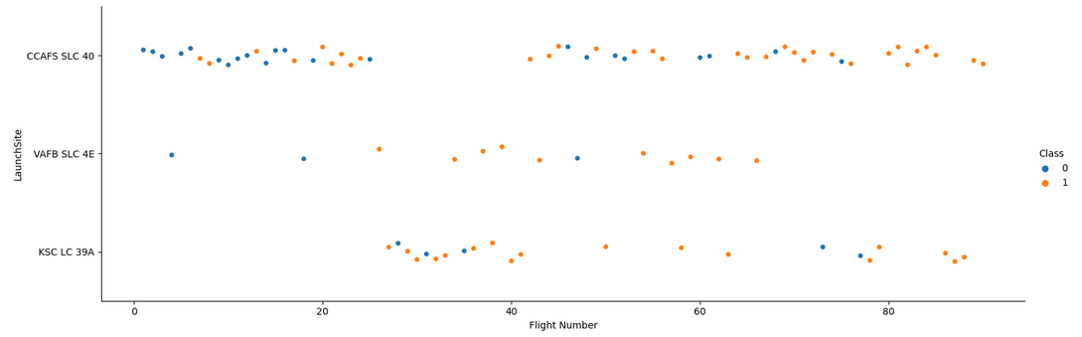
RESULTS: EDA with visualization
Flight Number vs. Launch Site
When class = 1 (amber dots), landing succeeded. We observe:
(1) there were more successful landings at higher flight numbers than lower
(2) launch site CCAFS SLC 40 serviced the most landings but VAFB SLC 4E had the highest success landing rate (17/22), the majority of which had higher flight numbers

Slide 12
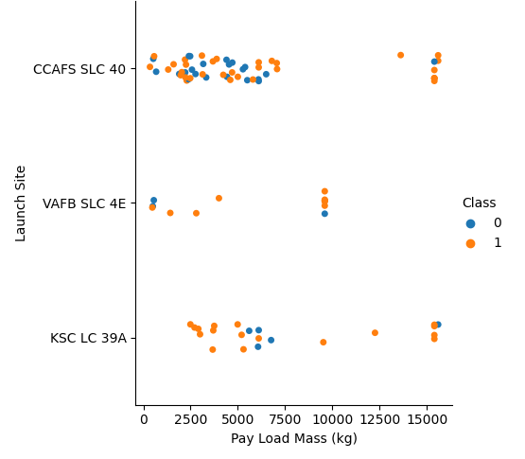
RESULTS: EDA with visualization
Payload vs. Launch Site
When class = 1 (amber dots), landing succeeded.
We observe:
(1) the VAFB-SLC launch site there
are no rockets launched for heavy payload mass (greater than 10000 kg).
(2) there is sufficient variance in succeed based on payload at every site so we may not infer a correlation with payload and success with this visualization

Slide 13
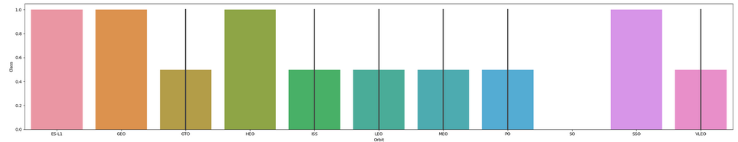
RESULTS: EDA with visualization
Success Rate vs. Orbit Type
We observe that the orbits with the highest success rate are:
ES-L1
GEO
HEO
SSO

Slide 14
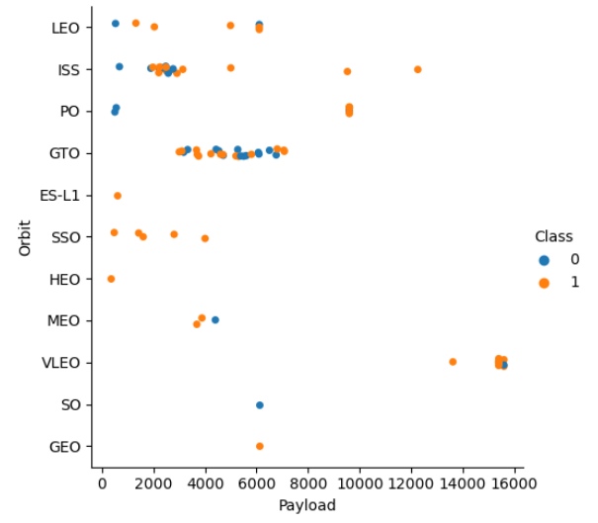
RESULTS: EDA with visualization
Payload vs. Orbit Type
When class = 1 (amber dots), landing succeeded.
We observe:
(1) LEO orbit success rate increases as flight number increases
(2) ES-L1, SSO, HEO, and GEO have 100% success rate, though the only one of these with multiple launches was SSO
(3) no correlation to success is distinguishable for ISS, PO, GTO, or VLEO orbits or flight numbers

Slide 15
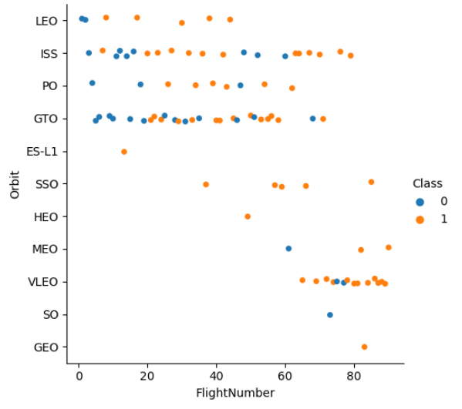
RESULTS: EDA with visualization
Flight Number vs. Orbit Type
When class = 1 (amber dots), landing succeeded.
We observe:
(1) Heavy payloads correlate with higher successful landing rates for PO, LEO, and ISS orbits
(2) there is no inferred correlation between payload and success rates in other orbit types.

Slide 16
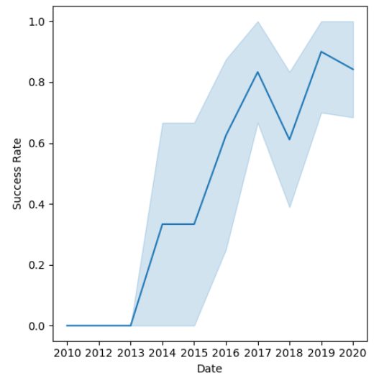
RESULTS: EDA with visualization
Launch Success Yearly Trends
We observe:
(1) Landing success rate increases, with the confidence interval, from 2013 to 2018
(2) Landing success rate varies from 2018 to 2020, suggesting a stabilized process

Slide 17
RESULTS: EDA with SQL
Query:
Display the names of the unique launch sites in the space mission
%sql SELECT DISTINCT LAUNCH_SITE FROM SAPCEXTBL;
Result:
• CCAFS LC-40
• CCAFS SLC-40
• KSC LC-39A
• VAFB SLC-4E

Slide 18
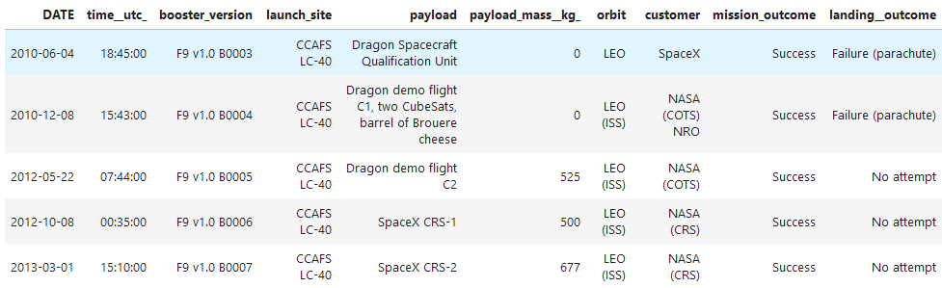
RESULTS: EDA with SQL
Query:
Display 5 records where launch sites begin with the string 'CCA'
%sql SELECT * FROM SAPCEXTBL WHERE LAUNCH_SITE LIKE 'CCA%' LIMIT 5;
Result:

Slide 19
RESULTS: EDA with SQL
Query:
Display the total payload mass carried by boosters launched by NASA (CRS)
%sql SELECT SUM(PAYLOAD_MASS__KG_) FROM SAPCEXTBL WHERE CUSTOMER = 'NASA (CRS)';
Result:
45596

Slide 20
RESULTS: EDA with SQL
Query:
Display average payload mass carried by booster version F9 v1.1
%sql SELECT AVG(PAYLOAD_MASS__KG_) FROM SAPCEXTBL WHERE BOOSTER_VERSION = 'F9 v1.1'
Result:
2928

Slide 21
RESULTS: EDA with SQL
Query:
List the date when the first successful landing outcome in ground pad was achieved.
Hint: Use min function
%sql select min(DATE) from SAPCEXTBL where Landing__Outcome = 'Success (ground pad)';
Result:
2015-12-22

Slide 22
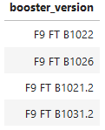
RESULTS: EDA with SQL
Query:
List the names of the boosters which have success in drone ship and have payload mass greater than 4000 but less than 6000
%sql SELECT BOOSTER_VERSION from SAPCEXTBL WHERE LANDING__OUTCOME = 'Success (drone ship)' and PAYLOAD_MASS__KG_ >4000 and PAYLOAD_MASS__KG_ <6000;
Result:

Slide 23
RESULTS: EDA with SQL
Query:
List the total number of successful and failure mission outcomes
%sql select count(MISSION_OUTCOME) from SAPCEXTBL where MISSION_OUTCOME = 'Success' or MISSION_OUTCOME = 'Failure (in flight)';
Result:
100

Slide 24
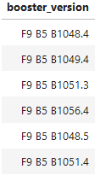
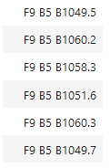
RESULTS: EDA with SQL
Query:
List the names of the booster_versions which have carried the maximum payload mass. Use a subquery
%sql SELECT BOOSTER_VERSION FROM SAPCEXTBL WHERE PAYLOAD_MASS__KG_ = (SELECT max(PAYLOAD_MASS__KG_) FROM SAPCEXTBL);
Result:

Slide 25

RESULTS: EDA with SQL
Query:
List the records which will display the month names, failure landing_outcomes in drone ship ,booster versions, launch_site for the months in year 2015.
Note: SQLLite does not support monthnames. So you need to use substr(Date, 4, 2) as month to get the months and substr(Date,7,4)='2015' for year.
%sql SELECT substr(Date, 6, 2) AS Month, substr(Date,1,4) AS Year, LANDING__OUTCOME, BOOSTER_VERSION, LAUNCH_SITE FROM SAPCEXTBL where substr(Date,1,4)='2015' AND LANDING__OUTCOME = 'Failure (drone ship)';
Result:

Slide 26
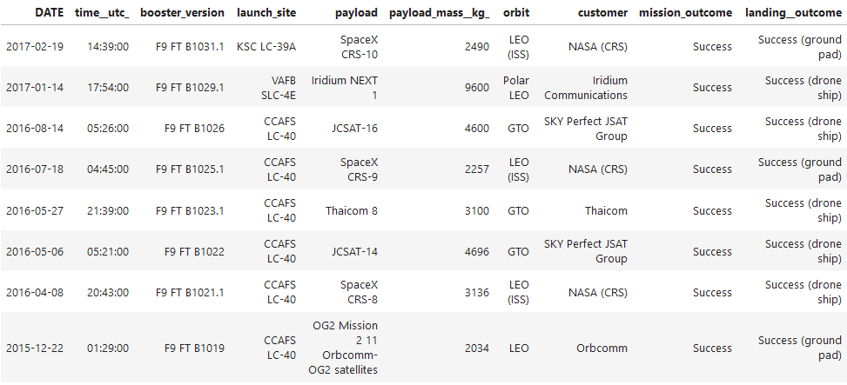
RESULTS: EDA with SQL
Query:
Rank the count of successful landing_outcomes between the date 04-06-2010 and 20-03-2017 in descending order.
%sql select * from SAPCEXTBL where Landing__Outcome LIKE 'Success%' and (DATE between '2010-06-04' and '2017-03-20') order by date desc;
Result:

Slide 27
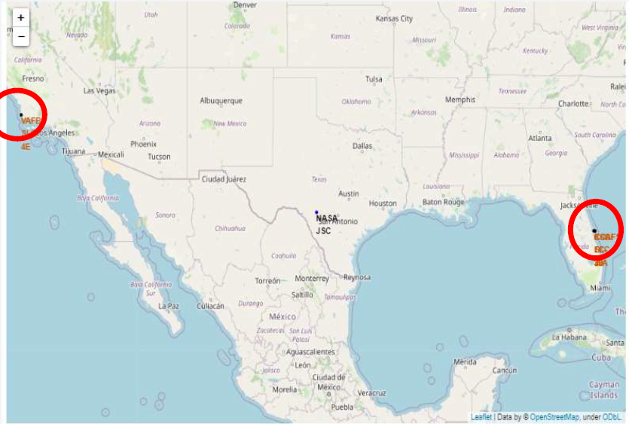
RESULTS: interactive map with Folium
Map launch sites
We observe:
(1) all launch sites are within 1000km of the earth's equator
(2) all launch sites are near the coastline

Slide 28
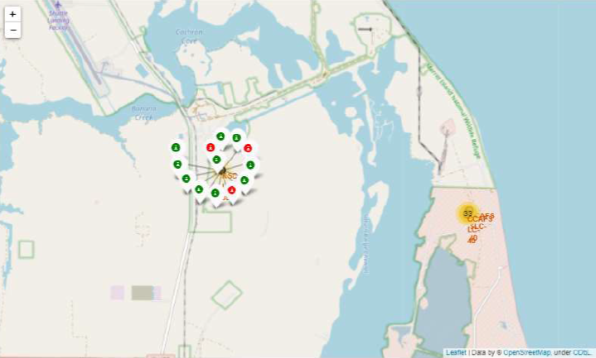
RESULTS: interactive map with Folium
Display success/failed launches for each site
We observe:
(1) Color coded launch successes and failures agrees with SQL data analysis that we cannot infer any correlation between launch site and success rate

Slide 29
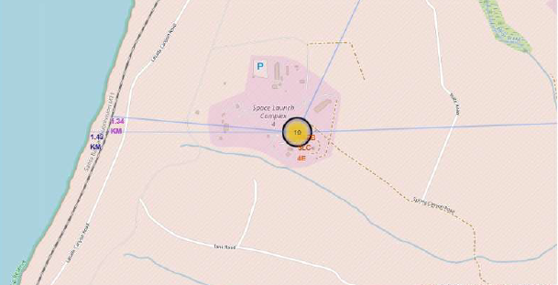
RESULTS: EDA with visualization
Draw distance polylines between a launch site to its proximities
We observe:
(1) All launch sites are near trains and roads
(2) All launch sites are near the coastline

Slide 30
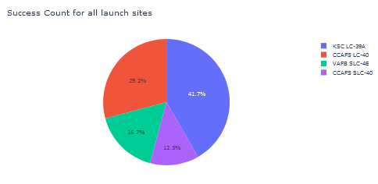
RESULTS: Plotly Dash dashboard
Pie chart: total successful launches count for all sites
We observe:
(1) Highest number of successful launches occurred at KSC LC-39A

Slide 31
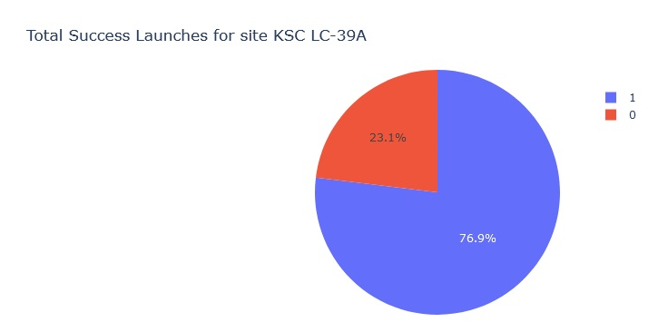
RESULTS: Plotly Dash dashboard
Pie chart: Successful vs. Failure launch rate by site
We observe:
(1) The highest launch success rate occurred at KSC LC-39A, 76.9%

Slide 32
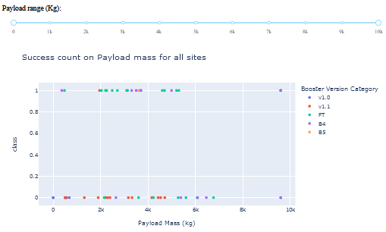
RESULTS: Plotly Dash dashboard
Which payload range(s) has the highest launch success rate?
Which payload range(s) has the lowest launch success rate?
We observe:
(1) Highest launch success rates occur between ~2000kg and ~5800kg payloads
(2) Highest failure rates occurred between ~1300kg and ~6800kg payloads

Slide 33
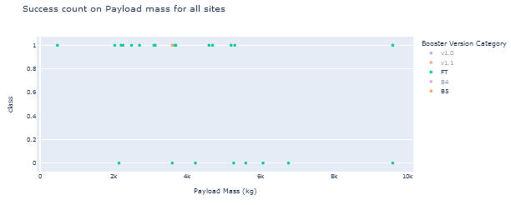
RESULTS: Plotly Dash dashboard
Which F9 Booster version (v1.0, v1.1, FT, B4, B5, etc.) has the highest launch success rate?
We observe:
(1) Highest success rate (100%) was the B5 booster, but it was only launched once, which is too small a sample to infer any trend
(2) Next highest success rate (59.1%) was the FT booster

Slide 34
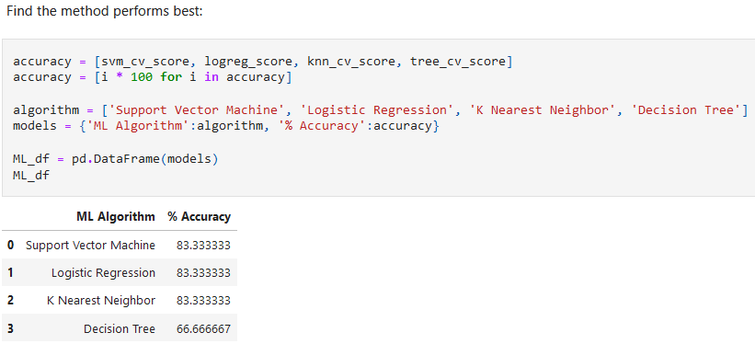
RESULTS: predictive analysis (classification)
We built four classification machine learning models using the Falcon 9 launch data, and ¾ supported 83.3% accuracy to predict launch success.

Slide 35
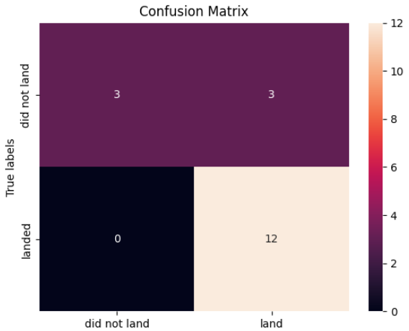
RESULTS: predictive analysis (classification)
Confusion Matrix: K Nearest Neighbor
The K nearest neighbor algorithm generally generates faster results than the other candidate algorithms, so we may select it for our predictive model.
From the confusion matrix for the K nearest neighbor model (pictured here), we observe:
(1) This model produces 3 erroneous predictions (type 1 – false positives, predicts 'land' when the data indicates 'did not land').

Slide 36
CONCLUSION
The data analysis of SpaceX Falcon 9 launch program suggests a benchmark required to compete with their reusable booster program:
All their launch sites are located near a coastline, with nearby transportation infrastructure (trains, highways).
Site KSC LC-39A had the highest launch success rate among all the launch sites.
From 2015 onwards, the success rate of rocket landings rose until possible stabilization of the process from 2018 onward. Any program should anticipate a similar improvement trajectory.
The B5 and FT boosters were most successful, but we cannot conclude they will be 100% successful
There is consistent variation of landing failure risk in ISS, PO, GTO, or VLEO orbits.
The best machine learning model we produced (without k-fold validation) can predict the landing outcome of rocket launches with 83.33% accuracy, but the errors were type 1 – false positives, predicting 'land' outcome when the data indicates 'did not land', which is generally worse than type 2 errors.

